Slide 1

Fundamental Rights are incorporated from Aricle 12 to 35 in the Third Chapter of the Indian Constitution Rights are the basic facilities which we need for our growth.These are the claims of individual recognised by the society and enforced by the State.The existence of Democracy can’t be imagined without Fundamental Rights in India because Rights are the pillars of Democracy

Slide 2
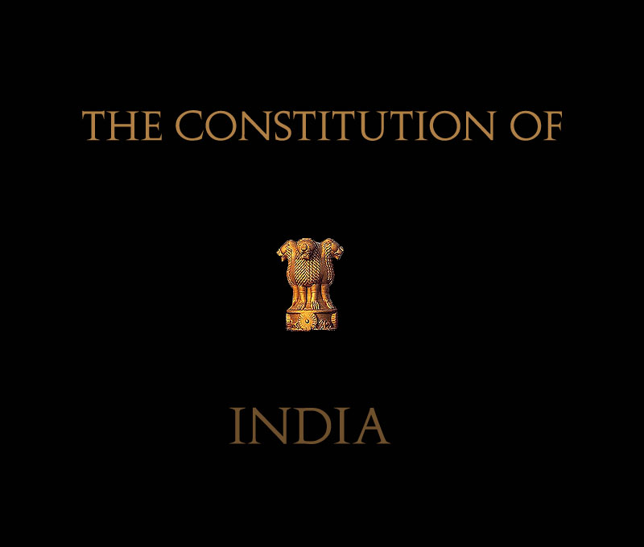

Slide 3

Article 12 {Definition}
In this Part, unless the context otherwise required, "the State" includes the Governmental and Parliament of India and the Government and the Legislature of each of the States and all local or other authorities within the territory of India or under the control of the Government of India.
Article 13 {Laws inconsistent with or in derogation of the fundamental rights}
All laws in force in the territory of India immediately before the commencement of this Constitution, in so far as they are inconsistent with the provisions of this Part, shall, to the extent of such inconsistency, be void.
The State shall not make any law which takes away or abridges the rights conferred by this Part and any law made in contravention of this clause shall, to the extent of the contravention, be void.
In this article, unless the context otherwise required, -
  "law" includes any Ordinance, order, bye-law, rule, regulation, notification, custom or usage having in the territory of India the force of law;
  "laws in force" includes laws passed or made by a Legislature or other competent authority in the territory of India before the commencement of this Constitution and not previously repealed, notwithstanding that any such law or any part thereof may not be then in operation either at all or in particular areas.
Nothing in this article shall apply to any amendment of this Constitution made under article 368.

Slide 4
Why do we call these Rights Fundamental?
These Rights are incorporated in the third Chapter of the Constitution of India.
They afford a basis for the development of an Individual.
The people and officials of India are ought to enjoy these rights.

Slide 5
Nature of Rights
Fundamental rights are equal for all.
Rights are justiciable – Article 32
Fundamental rights are not absolute.
They limit the authority of the central and state governments.
Fundamental rights distinguish between citizens and foreign nationals.
They can be suspended during emergency.
Parliament can amend Fundamental rights.

Slide 6

Right To Equality
Article 14 to 18

Slide 7
Right to Equality, Article-14 to 18
Equality before law Article-14 provides that «the state shall not deny to any person equality befor law or the equal protection of law within the territory of India ».
Prohibilition of Descrimination, Article-15
Equality of opportunity Article-16
Abolition of untouchability Article-17
Abolition of titles Article-18

Slide 8
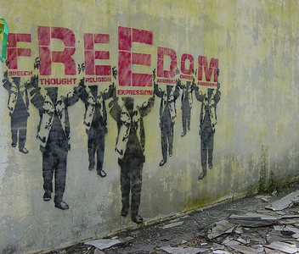
Right to Freedom
Article 19 to 22

Slide 9
Right to Freedom
Freedom of speech and expression Article-19
Freedom of Press – Article-361 A has been inserted according to which the press has been given the power to publish an account of the proceedings of the Indian Parliament and states legislatures.
Right to information is linked to the freedom of speech and expression granted in Article 19 in the constitution.
Freedom to assemble peacefully without Arms.
Freedom to form associations and unions.
Freedom to move freely throughout the territory of India.
Freedom to reside and settle in any part of the territory of India.
Freedom to practise any profession or to carry on any occupation,trade or business.
Protection in respect of conviction of an offence Article-20
Protection of life and personal liberty Article-21
Right to education Article-21 A
Protection against arrest and detention against certain cases Article-22

Slide 10
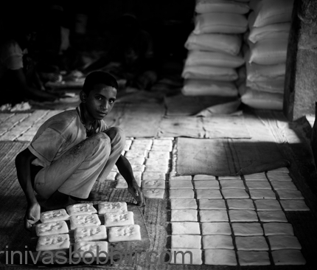
Right against Exploitation
Article 23-24

Slide 11
Right against exploitation,Article-23-24
Prohibition of traffic in human beings and forced labour Article23: This article prohibits the traffic in human beings and forced labour.
Prohibition of compulsary services Article-23 : under this article the state can force people to do compulsory service for public purposes.
Prohibition of Child Labour Article-24: Children below the age of forteen years will not be allowed to work in factories, mines or in other dangerous places so that their health is not adversely affected.

Slide 12
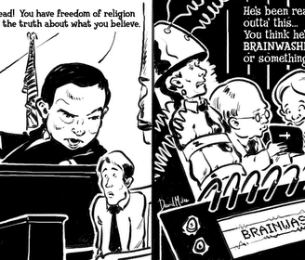
Right to Religious Freedom
Article 25 to 28

Slide 13
Right to religious freedom, Article-25 to 28
Freedom to profess and propagate any religion,Article-25
Freedom to manage religious affairs, Artcle-26
Freedom not to pay taxes for the promotion of any particular religion,Article-27
No religious instructions in government educational institutions,Artcle-28(1)
In private educational institutions religious education not against the will,Article-28(3)

Slide 14
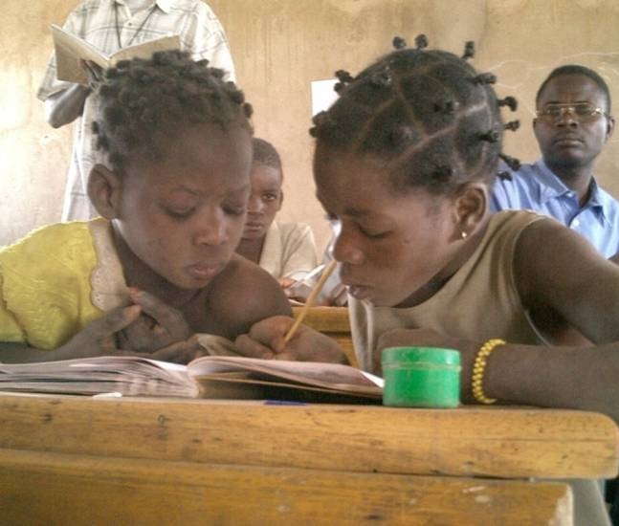
Cultural and educational rights
Article 29 to 30

Slide 15
Cultural and educational rights,Article 29 to 30
Protection against interest of minorities,Article-29(1)
Freedom to get admission in educational institutions,Article-29(2)
Right to minorities to establish educational institutions,Article-30(1)
No discrimination while giving grants-Article-30(2)

Slide 16
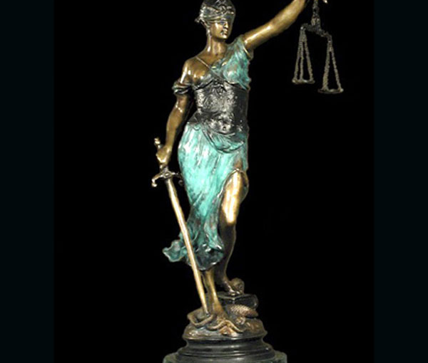
Right to Constitutional Remedies.
Article-32

Slide 17
Right to constitutional remedies,Article-32
Article-31(1), provides that a citizen can approach the supreme court of India by due process of law for the implementation of the Fundamental Rights included in Chapter 3 of the constitution.
Article-32(2), the Supreme court of India has the right to issue writs in the nature of the Habeas Corpus,Mandamus,Prohibition,etc.
Article-32(3), The Indian Parliament can empower any court to issue notice within its jurisdiction without infringing or influencing the powers of the Supreme Court of India.
Article-32(4), the state cannot suspend the right to constitutional remedies except in cases provided in the Indian Constitution.

Slide 18
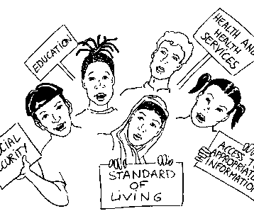
Critical Evaluation of Fundamental Rights
Public Opinion

Slide 19
Critical evaluation of fundamental rights
No rights outside the constitution
Too many limitations
Preventive Detention and Fundamental rights
Rights can be suspended during emergency
Absence of Economic rights
Vague and complex language
Supremacy of Parliament over Fundamental Rights
Special concessions for minorities and backward classes are against the Principle of Equality.

Slide 20
Importance of Human Rights
Foundation of democracy
Check on the arbitrariness of the Government
Create proper conditions for the development of Men
Foundation of Rule of law
Establishment of Secular state
Protection of the interests of the minorities
Reconciliation between individual interests and social interests.

Slide 21

Article 33. Power of Parliament to modify the rights conferred by this Part in their application to Forces, etc.- Parliament may, by law, determine to what extent any of the rights conferred by this Part shall, in their application to:-
(a) The members of the Armed Forces; or
(b) The members of the Forces charged with the maintenance of public order; or
(c) Persons employed in any bureau or other organisation established by the State for purposes of intelligence or counter intelligence; or
(d) Persons employed in, or in connection with, the telecommunication systems set up for the purposes of any Force, bureau or organisation referred to in clauses (a) to (c), be restricted or abrogated so as to ensure the proper discharge of their duties and the maintenance of discipline among them.
Article 34. Restriction on rights conferred by this Part while martial law is in force in any area.- Notwithstanding anything in the foregoing provisions of this Part, Parliament may by law indemnify any person in the service of the Union or of a State or any other person in respect of any act done by him in connection with the maintenance or restoration of order in any area within the territory of India where martial law was in force or validate any sentence passed, punishment inflicted, forfeiture ordered or other act done under martial law in such area.
Article 35. Legislation to give effect to the provisions of this Part.- Notwithstanding anything in this Constitution,-
(a) Parliament shall have, and the Legislature of a State shall not have, power to make laws-
(i) with respect to any of the matters which under clause (3) of article 16, clause (3) of article 32, article 33 and article 34 may be provided for by law made by Parliament; and
(ii) for prescribing punishment for those acts which are declared to be offences under this Part; and Parliament shall, as soon as may be after the commencement of this Constitution, make laws for prescribing punishment for the acts referred to in sub-clause (ii)
(b) any law in force immediately before the commencement of this Constitution in the territory of India with respect to any of the matters referred to in sub-clause (i) of clause (a) or providing for punishment for any act referred to in sub-clause (ii) of that clause shall, subject to the terms thereof and to any adaptations and modifications that may be made therein under article 372, continue in force until altered or repealed or amended by Parliament.

Slide 22
References
Avasthi, A.P, Indian Government and Politics, Narain Agarwal, Agra, 2001.
Badyal, J.S, Indian Government and Politics, Raj Publishers, Jalandhar, 2013.
Fadia, B.L, Indian Government and Politics, Sahitya Bhawan Publication, Agra, 2002
Ghai, U.R, Indian Government and Politics, New Academic Publishing, Jalandhar, 2002.
Gupta, D.C, Indian Government and Politics,Vikas Publishing House, New Delhi, 1978
Johari, J.C, Indian Government and Politics, Vishal Publication, 1979.

